Slide 1
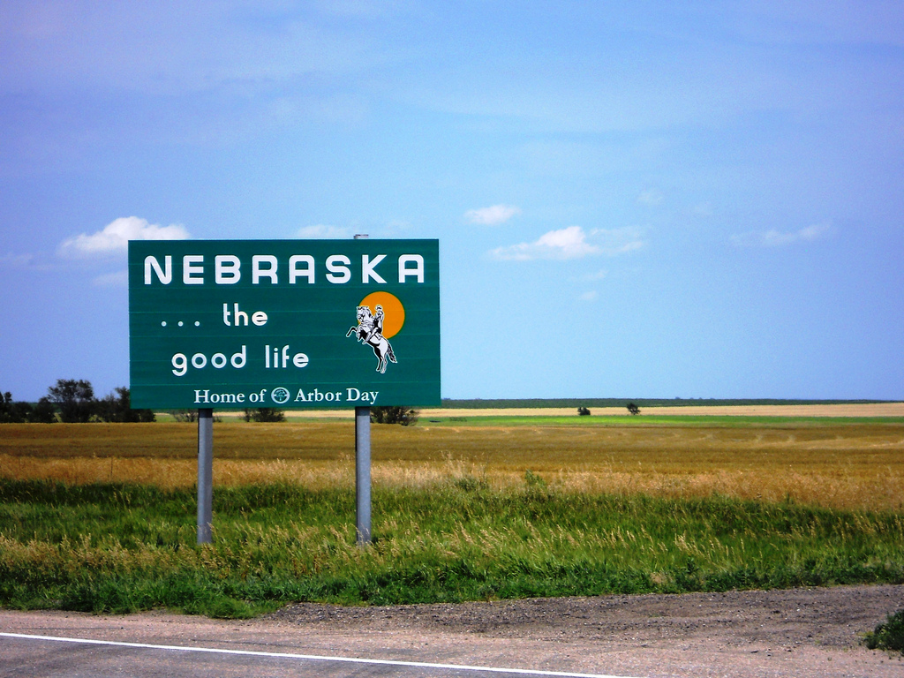
A Conversation About Confinement and The Purpose of Detention Session 1
Notes:
Beth Oprisch –Moderator

Slide 2
Today’s Webinar
Dangers of Detention
Adolescent Brain Development
Purpose of Detention
Cost of Detention
Notes:
Beth Oprisch –Moderator

Slide 3
Dangers of Detention
Notes:
Beth Oprisch –Moderator

Slide 4
Purpose of Detention (POD)
Nebraska POD
Arizona POD
The purpose of intake is to detain only those juveniles who pose a severe risk to the community or who are at risk to flee the jurisdiction. The most appropriate options which are the least restrictive and intrusive to the juvenile and their family will be chosen. The primary objective is to balance the best interest of the juvenile, family with the safety of the community.
Youth can be best served within their community and should only be detained if they present a risk to the community or a risk of failing to appear at the next court hearing.
Notes:
Monica/Michelle/David
Although statutes in Nebraska and Arizona allow youth to be detained for a variety of reasons, including risk to self, (facilitator can use examples of NE and AZ statutes), juvenile justice professionals in both states acknowledge that detention can be harmful and therefore have each developed a purpose of detention that narrows the ideal use of our most restrictive intervention beyond what is statutorily allowable.
Arizona Court Rule 23 Detention and Probable Cause Hearing
D. Detention Hearing. Probable cause may be based upon the allegations in a petition, complaint or referral filed by a law enforcement official, along with a properly executed affidavit or sworn testimony. If the charging document is an Arizona Ticket and Complaint form, the complaint shall also serve as an affidavit. The affidavit may serve as the oath before a magistrate for purposes of Rule 2.4, Ariz. R. Crim. P. The victim of the offense has the right to be heard at the detention hearing, as provided by law. A juvenile shall be detained only if there is probable cause to believe that the juvenile committed the acts alleged in the referral, petition, or complaint, and there is probable cause to believe;
1. The juvenile otherwise will not be present at any hearing; or
2. The juvenile is likely to commit an offense injurious to self or others; or
3. The juvenile must be held for another jurisdiction; or
4. The interests of the juvenile or the public require custodial protection; or
5. The juvenile must be held pending the filing of a complaint pursuant to A.R.S. 13-501.
NE: Our probation system has a statewide intake sub-committee that is headed up by Michele on my staff. The committee created that statement several years ago, so it is our expected philosophy for all of our districts as it relates to juvenile intake. We share it when we train local law enforcement and other stakeholders as well as all new probation officers go through intake training so they understand this expectation.
AZ: POD defined by the state-level JDAI Advisory Committee

Slide 5
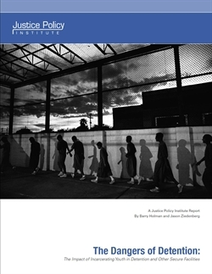
Detention is harmful and does not promote public safty when not reserved for the most serious cases
Increases Recidivism and does not reduce crime.
Pulls kids deeper into the system and slows the natural “aging out of delinquency” Alternatives are more effective at reducing recidivism and at a fraction of the cost.
Detention produces depression and makes mentally ill youth worse.
Increases risk of self harm (communities have seen double to four times the rate of suicide for youth detained).
Youth with special needs fail to return to school.
Impedes later success in labor market.
Not cost effective.
Has increasingly locked up youth of color at disproportional rates.
Notes:
David Redpath

Slide 6
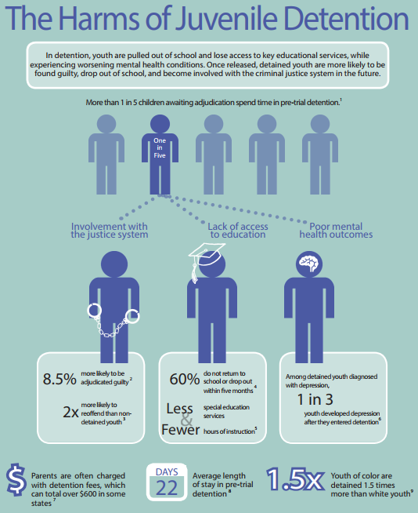
8.5% more like to be adjudicated
2x more likely to reoffend
60% do not return to school or dropout within 5 months
Less access to special education services
Fewer hours of Instruction
Notes:
David Redpath
1 in 5 youth awaiting adjudication spend time in detention
Findings based on research from the Justice Policy Institute, Annie E. Casey Foundation, OJJDP statistical briefing book
*print off as a handout as well

Slide 7
Who are the youth in detention facilities?
85% of children in juvenile detention have at least one disability; however, only 37% received special education services in their schools
African American youth are more likely to go through school with untreated disabilities and to be diagnosed with behavioral disabilities
Often youth are more at risk of contact with the juvenile justice system as a result of unmet mental health needs.
It's estimated that between 60% and 80% of incarcerated youth possess a mental-health condition, compared to 7 to 17% of general-population youth
Notes:
David Redpath
85% of incarcerated youth have a disability, but just 37% of them received special education services in school. At the same time, special education programs often function as a new form of school segregation that place disabled children on a track toward unequal outcomes, according to the National Council on Disability.
African American children are more likely to go through school with untreated disabilities and to be diagnosed with behavioral disabilities that funnel them into what could be called a special-education-to-prison pipeline. Children in poverty are impacted harshly by having a disability, because it’s more difficult for them to access resources outside of those offered by their public school. Native kids with disabilities are twice as likely as their white counterparts to receive out-of-school suspension, and three times as likely to be physically restrained in school.
A report released in August 2017 by the Ruderman Family Foundation shows that children with “non-apparent disabilities” — meaning those not immediately visible, such as learning disabilities, autism, Crohn's disease, or mental illness — are routinely criminalized rather than given the educational accommodations to which they are legally entitled.
Some behaviors that cause youth to be arrested are manifestations of a disorder in need of treatment. (Thomas Grisso, “Adolescent Offenders with Mental Disorders,” The Future of Children 18, no. 2 (2008): 143-164.)
* Braking the School –to-Prison-Pipeline for Students with Disabilities, National Council on Disability, 2015. https://www.ncd.gov/publications/2015/06182015
* http://www.rimed.org/rimedicaljournal/2016/09/2016-09-24-adolescent-gergelis.pdf
* *Thomas Grisso, “Adolescent Offenders with Mental Disorders,” The Future of Children 18, no. 2 (2008): 143-164.

Slide 8
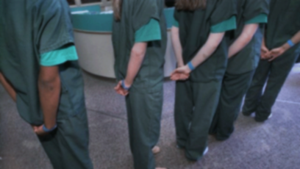
Negative Impact
Reduce educational and vocational outcomes
Disrupt families
Introduction to delinquent peers
Exposure to traumatic experiences
Exacerbate mental illness
Recidivism rates 50% or higher for individuals who remain in secure facilities
Negative impact on community safety
Notes:
David Redpath
The research indicates that incarcerating young people often leads to:
Poor education and employment outcomes
Disrupts positive support systems
Often introduces young people to higher risk peers
Exposure to traumatic experiences like strip searches that can retraumatize young people
Exacerbate existing mental health conditions like depression and increase suicidal ideations.
Youth recidivism rates within states are often reported at 50 percent or higher for individuals who remain in secure facilities. Further, court records show that youth experience a greater likelihood of returning to court after each criminal referral they receive.
As many as 50 to 70 percent of youth who were previously in residential placement facilities were rearrested within two years of their release. Increased recidivism is has an adverse effect on public safety.
* A. Golub, The Termination Rate of Adult Criminal Careers (Pittsburgh: Carnegie Mellon, 1990)
* 40 Robert A. Sampson and John H. Laub, Crime in the
* H. Snyder, Court Careers of Juvenile Offenders (Washington, D.C.: U.S. Department of Justice, Office of Justice Programs, Office of Juvenile Justice and Delinquency Prevention, 1988). www.eric.ed.gov/ERICDocs/data/ericdocs2sql/content_storage_01/0000019b/80/1f/95/84.pdf.
Tie slide to previous via narrative and or within the slide.

Slide 9
Increased Recidivism
• In 443 studies 63% of young people who received community-based treatment and other alternatives to incarceration were less likely to recidivate.
• In Texas, researchers found that young people in community-based placement are 14% less likely to participate in illegal behavior than youth that have been incarcerated.
Notes:
David Redpath
* Mark W. Lipsey, “Juvenile Delinquency Treatment: A Meta-Analytic Inquiry into the Variability of Effects,” in Meta-Analysis for Explanation: A Casebook, ed. T.D. Cook, H. Cooper, D.S. Cordray, H. Hartmann, L.V. Hedges, R.J. Light, T.A. Louis, and F. Mosteller (New York, NY: Russell Sage Foundation, 1992).
* In a 12-year study that compared the outcomes of 266 juvenile defenders in Texas placed in correctional centers and alternatives to detention centers, Fendrich and Archer found that the recidivism rate of youth in alternatives was 65 percent, whereas the recidivism rate of those placed in correctional facilities was 71 percent. Michael Fendrich and Melanie Archer, “Long-Term Re-Arrest Rates in a Sample of Adjudicated Delinquents: Evaluating the Impact of Alternative Programs,” The Prison Journal 78, no. 4 (1998): 360-389.
Several studies have shown that youth who are incarcerated are more likely to recidivate than youth who are supervised in a community-based setting, or not detained at all
Researchers found that in 63.4 percent of 443 studies about the juvenile justice system, young people who received interventions emphasizing community-based treatment and other alternatives to incarceration were less likely to recidivate than those who did not receive an intervention. For example, 32 to 37 percent of young people given employment and behavioral programs were estimated to recidivate, as compared to a 50 percent recidivism rate for the group of youth not given this intervention.
• In Texas, researchers found that young people in community-based placement are 14 percent less likely to participate in illegal behavior than youth that have been incarcerated.
Other ideas, recidivism stats or replace
Closer to home – verify information

Slide 10
Judge Hochuli Juvenile Court Judge in Pima County
Examples from the Bench
Brain Development
Going deeper into the system
Exposing lower risk youth to higher risk youth
Learning more about criteria for detainment and the use of discretion at the intake level
Notes:
Judge Hochuli
Start discussion with position at CA’s office and looking at initial development of criteria for detainment.
Brain development - think about the stupid things we all did as kids (Hobo Joe example) Things kids see as pranks and funny and don’t weigh out the potential consequences
Going Deeper in the system – Diversion being offered to avoid going deeper if at all possible
Exposure to higher risk youth by being detained
Seeing the use of discretion by the Intake

Slide 11
Judge Roland Judge of the County Court, 12th Judicial District
Examples from the Bench
Distance from facility
Distance from family
Placement availability
Viable local options
Notes:
Judge Roland

Slide 12
Adolescent Development and the Impact of Detention
Notes:
Beth Oprisch

Slide 13
What We Know
Notes:
Angie
Psychosocial capacities such as impulse control, future orientation, and/or resistance to peer influence continue to develop into young adulthood.
Various factors can undermine adolescent development and decision making such as stress, fear, learning difficulties, previous victimization and peers.
Risky adolescent behavior does not predict enduring antisocial traits.

Slide 14
The Supreme Court
Roper v Simmons (2005): The youth lacks maturity and have an underdeveloped sense of responsibility, resulting in impetuous and ill-considered actions and decisions.
Graham v Florida (2009): The Constitution does not permit a juvenile offender to be sentenced to life in prison without parole for a non-homicide offense.
Miller v Alabama (2012): Mandatory sentences of life without the possibility of parole are unconstitutional for juvenile Offenders - extending beyond the Graham v Florida case.
Montgomery v Louisiana (2016): The previous ruling in Miller v. Alabama, that a mandatory life sentence without parole should not apply to persons convicted of murder committed as juveniles, should be applied retroactively.
Notes:
Hochuli
The US Supreme Court has recognized the research about adolescent development in the last several years with landmark decisions eliminating the juvenile death penalty and juvenile life without parole.
Roper V Simmons: youth are more vulnerable and susceptible to negative influences and outside pressures, including peer pressure; and
the character of a youth is not as well formed as that of an adult. Thus, they possess far more potential for rehabilitation.

Slide 15
Ageing Out
YOUTH SELF REPORTING CRIMINAL ACTIVITY
Total = 86%
Longitudinal studies begun in the 1950s show most juvenile offenders age out of criminal behavior
Researchers believe this is because the transition to young adulthood ‘cements’ bonds to society and deters most from continued criminality
Arrested during adolescence
Most youth age out of criminal behavior on their own
Self-reported criminal activity, but not arrested
Notes:
Angie
This slide illustrates the research that shows most youth grow out of delinquent behavior on their own.
Most young people involved with the juvenile justice system will desist from criminal behavior simply as a result of maturation.” - Reforming Juvenile Justice: a Developmental Approach. National Academy of Sciences, Committee on Assessing Juvenile Justice Reform (2013)
Note: Criminalizing adolescent behavior – slide information give specific examples
Source: Data from National Youth Survey analyzed by Hawkins, D., Smith, B. and Catalano, R. “Delinquent Behavior,” in Pediatrics in Review (2002: 23: 382-392); “Unraveling Juvenile Delinquency” (Glueck, 1963), with followup in “Crime in the Making” (Sampson and Laub, 1993)

Slide 16
Confinement
Interrupts a youth’s ability to develop independent decision making skills;
Susceptibility to peer influences and confinement places them with negative peers. This has a negative impact on recidivism for low risk youth;
Removes youth from family, education and community supports necessary for positive adolescent growth
Notes:
Angie
At a time when a youth’s susceptibility to peer influences is highest, confinement puts them in close proximity to extremely negative peers. This particularly has a negative impact on recidivism for low risk youth

Slide 17
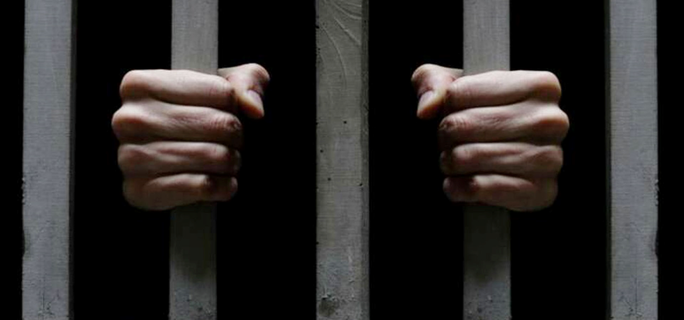
“For the youth in the justice system, the program or facility in which he or she is placed becomes the developmental setting and thus can have a substantial impact- positive or negative- on the youth’s future developmental trajectory in ways that may affect recidivism.”
National Academy of Sciences
Notes:
Angie
**Environment matters! A negative environment will impact positive development.

Slide 18
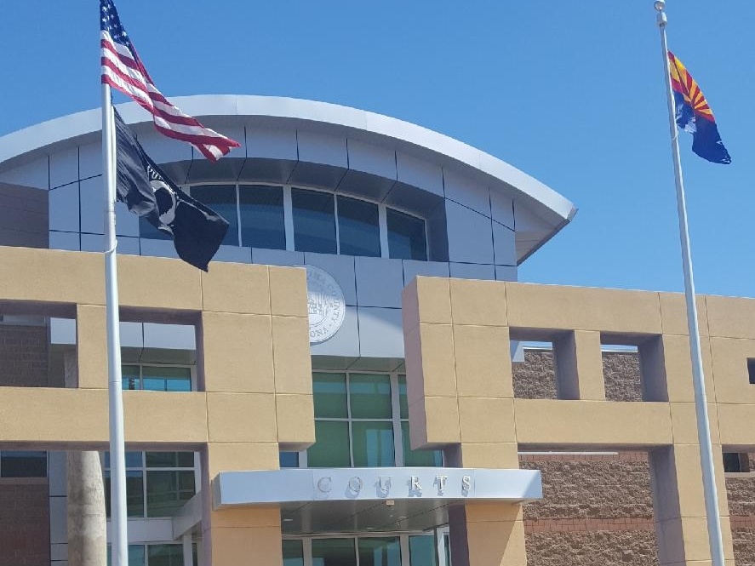
Purpose of Detention
Pima County Juvenile Court
Notes:
Sheila

Slide 19
Pima County Demographics
By Ethnicity
By Race
Notes:
Sheila

Slide 20
Arizona Rules of Procedure for the Juvenile Court
Detention and Probable Cause Hearing: Rule 23(d)
Will not be present, flight risk
Likely to commit an offense injurious to self or others
Must be held for other jurisdiction
Interests of minor or public require custodial protection
Must be held pending filing of complaint in adult court
Notes:
Sheila/Judge Hochuli
******Contrary to Welfare Findings
Will not be present, flight risk :
Totality of circumstances includes:
How many FTA’s, RJA’s and Warrants do they have ?
When was the last time they had a FTA/RAJ or Warrant?
What have been the causes of these?
Parent/Guardian/DCS not transporting?
Didn’t have the means to get to Court (ie: bus pass)?
Parent/youth work or school conflicts?
High Risk to re-offend, victim offenses
Physical harm to others, weapons, stealing cars, burglarizing residences
Sex Trafficking victim
Neighboring County or Out of State Warrant
Immigration and Customs Enforcement Hold (only under special circumstances) Material witness and their safety is at risk
Trauma vs. Safety
D. Detention Hearing. Probable cause may be based upon the allegations in a petition, complaint or referral filed by a law enforcement official, along with a properly executed affidavit or sworn testimony. If the charging document is an Arizona Ticket and Complaint form, the complaint shall also serve as an affidavit. The affidavit may serve as the oath before a magistrate for purposes of Rule 2.4, Ariz. R. Crim. P. The victim of the offense has the right to be heard at the detention hearing, as provided by law. A juvenile shall be detained only if there is probable cause to believe that the juvenile committed the acts alleged in the referral, petition, or complaint, and there is probable cause to believe;
1. The juvenile otherwise will not be present at any hearing; or
2. The juvenile is likely to commit an offense injurious to self or others; or
3. The juvenile must be held for another jurisdiction; or
4. The interests of the juvenile or the public require custodial protection; or
5. The juvenile must be held pending the filing of a complaint pursuant to A.R.S. 13-501.

Slide 21
Why Not Detain on 23(d)?
Parent/Guardian/DCS role in appearing for court
There is a safe place to release
Potentially a victim
Negative demeanor
No charges pending (ie: ICE Holds)
The impact of detaining will cause greater trauma than the risk to the community
Notes:
Judge Hochuli

Slide 22
Pima County Alternatives
GPS Monitoring
Evening Reporting Center
Community Partners and Resources
Alternative Community Engagement Services Center (ACES)
Notes:
Sheila
GPS Monitoring
PO’s more likely to request release with this option available due to better tracking ability
Doesn’t require a land line
Many families don’t have land lines by choice any more
Many families can’t afford a land line
Many times we see this as the case with families of color which increases the likelihood of DMC
Evening Reporting Center
Provides additional supervision after school
Connects with community resources/partners
Community Partners and Resources
VITAL to re-engaging youth with their communities
Identifying a partner or resource that the youth will be engaged with and connects with
ACES/DVAC
ALL misdemeanor DV referrals go here instead of being taken to Detention
Early intervention to reduce likelihood of some youth coming to Detention

Slide 23
Nebraska Rev. Stat. 43-248
Juvenile may be taken into temp. custody when:
Age of juvenile is 11 years or older
Immediate removal necessary for juvenile’s protection
Reasons of mental illness and dangerous, risk of harm before court hearing
Reasonable grounds to believe juvenile has run away
Reasonable cause to believe juvenile is in VOP and that juvenile is flight risk or danger to lives/property
Truancy, or
Reasonable grounds to believe juvenile is immune from prosecution for prostitution under Neb. Rev. Stat. 28-801(5)
Notes:
Judge Roland
Temp. Custody of Juvenile Without Warrant

Slide 24
Alternatives to Detention
Shelter placements
Family
Respite foster care, if available
Electronic monitoring
Alcohol monitoring bracelet
Drug patches
Tracker services
Team planning for new solutions
Notes:
JUDGE ROLAND
Nebraska Alternatives to Detention Utilized by Judge Roland

Slide 25
Existing Resources
Increase frequency of hearings
Technology – WebEx, Jabber
Troubleshooting tech issues
On-call probation officer
Probation safety planning
Participation of Sidney High School administration in Court process
Through the Eyes of the Child Team
Notes:
Judge Roland
Other Notable Resources

Slide 26
Cost of Detention
Notes:
Beth Oprisch

Slide 27
What are the Costs?
Youth fall behind with their education
Youth lose connections with positive peers in exchange for connections with potentially negative peers
Youth lose connection with family
Financial costs to families, communities, counties and the state
Notes:
Michele/Monica
Discuss each bullet and how the impact of detention costs more than just money. When a young person is detained, their education is impacted and young people are at a higher risk to drop out of school and not complete their education, which in the long term has negatives effects for the youth, their family and the community.
The belief is that by putting a young person into detention this will get them away from the negative peers they have, this might be true for some youth, but when we put young people in detention any connections with positive peers/supports is no longer there and the young people are exposed to potentially high risk youth who have more experience with high risk behaviors. In turn, these youth may be learning more and even worse behaviors by being exposed to high risk youth.
Due to the geography, when a youth is placed in detention, the likelihood of the youth maintaining contact with their family is minimal. Due to family resource issues and the fact the detention center may be anywhere from 2-7 hours away it is almost impossible for many of our families to maintain contact with their child while they are in detention. When this occurs, the youth may act out and find themselves in more trouble because they are unable to maintain contact with their family. Could you imagine, being 13-14 years old and going to a facility across the state and not knowing anyone?
The financial costs can be staggering when we look at the long term impacts detention can have on a youth. If a young person doesn’t finish school and finds themselves continuing to get into trouble as they age out of the system, financially the county/state continue to be responsible for this youth. If a youth isn’t able to get a job in order to support their family, this too also has negative outcomes for society. Breaking down the actually costs for a youth to be in detention can be surprising for many.

Slide 28
Financial Costs
Law enforcement officers time to transport youth, taking them away from the community
Housing a youth at a detention facility
Cost of transportation to and from detention facility
Notes:
Michele/Monica

Slide 29
Cost Comparison
Detention
$1,400-1,992 Facility Costs
$1,200 Round Trip Mileage
$300 Law enforcement salary
$2,900-$3,222 Total Cost for 7 days of secure
detention
Alternatives to Detention
$225 Tracker Services
$140 Electronic Monitoring
$1,260 Shelter Care
$1,625 Total for all three ATD’s for 7 days
Notes:
Monica/Michele
This chart shows the financial cost for detaining a youth versus utilization of an alternative to detention.
Jurisdictions across Nebraska have different alternatives, these are the most common.
All totals are based off of seven days in detention or on the alternative to detention.
For Mileage: this is one round trip to take the youth to detention and for the law enforcement officer to return home. This total is based off of a youth traveling from Western Nebraska to Eastern Nebraska where detention facilities are located. Law enforcement salary is based off of an hourly rate of $25.00 an hour and does not include any overtime or additional expenses for travel.
Keep in mind, when a youth is in detention they do not receive any type of treatment (mental health or substance abuse), their education may be delayed or stop all together and no specific work is being done to address behavior change. If youth are placed on an ATD, treatment services could continue to start while the youth remains in the community.
To house a youth in detention for 7 days the cost to taxpayers range from:
$1,400-$1,932
If a youth has to be transported, cost to taxpayers can cost up to $600.00 (one way) not including the law enforcement officers time and the fact they are not in their communities.
Total estimated costs for housing a youth in detention for 7 days ranges from
$2,600-$3,232

Slide 30
Detention Costs in Nebraska
Judge Roland: Costs and logistics seen in County Courts in the 12th Judicial District in Nebraska
Notes:
Judge Roland

Slide 31
Doing Things Differently
While in detention, young people do not receive any form of treatment or services
Funds spent on detention could be repurposed into community based options while maintaining community safety
Community based interventions can lead to behavioral change, which benefits the youth, their family and our communities
Notes:
Monica/Michele
David
Pima County – Talking points wrap up

Slide 32
Next Steps/ Questions?
Session 2 March 13th
12:30-1:30 (Central)
A Conversation about confinement and the purpose of detention
Objective Risk Assessment Instruments
A Conversation from the Bench
Alternatives to Detention
Notes:
Beth Oprisch

Slide 33
Resources
National Juvenile Defender Center, http://njdc.info/
JDAIconnect, www.jdaiconnect.org
Resolution Regarding Juvenile Probation and Adolescent Development https://www.ncjfcj.org/sites/default/files/Fnl_AdoptedProbationPolicyResolution_7-2017_1.pdf
NJDC Adolescent Development Bench Card http://njdc.info/wp-content/uploads/2017/08/NJDC_Adolescent-Development_Bench-Card.pdf
Notes:
Michele Monica

